Slide 1
Static Analysis

Slide 2
Some Common Terms
Dynamic:
Changing over time
While the program is running/executing
Static:
Unchanging
"Before" the program is running

Slide 3
Static Analysis of a Program
Defined:
The automated review of a program (or a part of a program) "before" it is executed
Possible Inputs:
Source code
Compiled/partially-compiled code

Slide 4
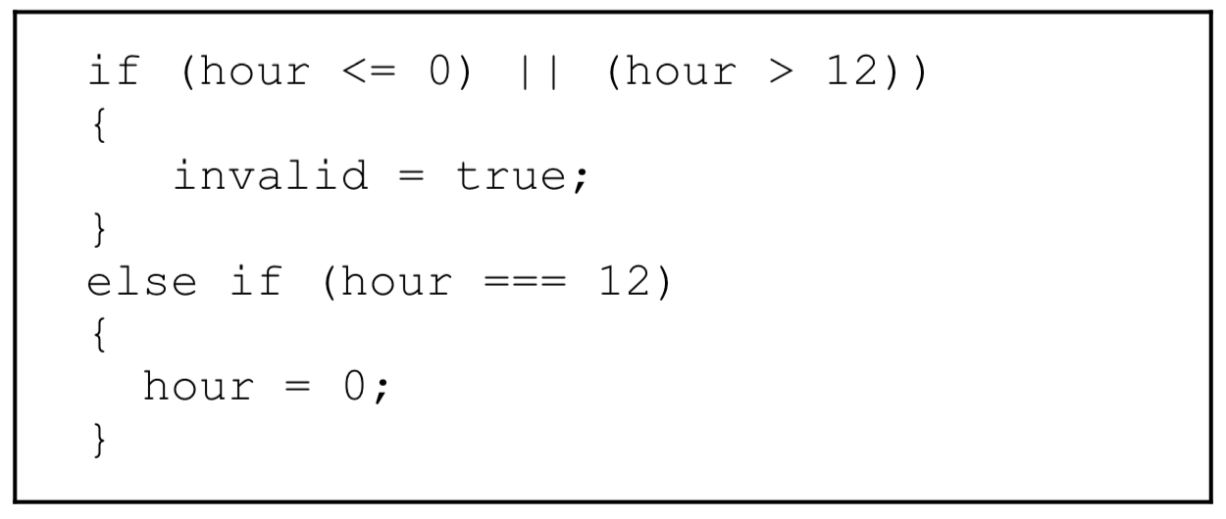
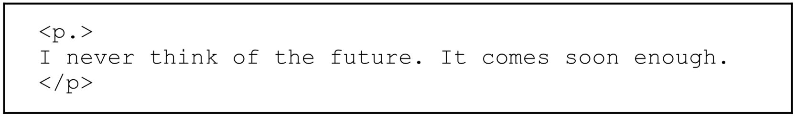
Kinds of Static Analysis
Syntax Checking:
To ensure software obeys the grammatical rules of the language it is written in.

Slide 5
Kinds of Static Analysis (cont.)
Style Checking:
Syntactically correct but stylistically inappropriate
Construct Checking:
"Suspicious" constructs (e.g., variables used but not initialized, division, unused variables, constant logical expressions, etc...)
Non-portable constructs (e.g., potential range problems)
Memory allocation inconsistencies
Language-specific idiom and usage checker
E.g. in JavaScript, an idiom and usage checker might flag grades = new Array() rather than grades = [], which is purely an idiomatic matter peculiar to JavaScript.
Notes:
Always check the return value, but for clarity, it's common to wrap malloc() in a function which never returns NULL:
void * emalloc(size_t amt)
{ void *v = malloc(amt);
if(!v){ fprintf(stderr, "out of mem\n");
exit(EXIT_FAILURE); }
return v; }
Then, later you can use
char *foo = emalloc(56); foo[12] = 'A';
https://stackoverflow.com/questions/7940279/should-we-check-if-memory-allocations-fail

Slide 6
Kinds of Static Analysis (cont.)
Software Metrics:
Thousand Lines of Code (KLOC)
Source Lines of Code (SLOC or LOC)
Logical Lines of Code (LLOC)
E.g., for (i = 0; i < 100; i += 1) printf("hello"); /* How many lines of code is this? */

Slide 7
Kinds of Static Analysis (cont.)
Cyclomatic Complexity (calculated from the nodes and edges in the control flow graph)
Independent path is a path that has at least one edge that has not been traversed before in the given graph.
Methods:
Count the number of regions on the graph
No. of edges – No. of nodes + 2
No. of predicates + 1
1
2
3
7
4
5
6
8
9

Slide 8
Kinds of Static Analysis (cont.)
Halstead Complexity (calculated from the number of operators and operands)
To reflect the implementation or expression of algorithms in different languages, but be independent of their execution on a specific platform
Formal Methods:
Model Checking (determine if the program satisfies all requirements)
Data Flow Analysis (calculate the possible set of values using the control flow graph)
Symbolic evaluation (tracing the execution of a program using symbolic values)

Slide 9
Some History
FORTRAN:
As early as 1954 FORTRAN compilers included static analysis tools for optimization
lint:
Developed at Bell Labs in the mid 1970s to find the "undesirable fiber and fluff" in C programs
One of the first style checkers
Software Assurance Marketplace (SWAMP):
Trying to become a free central repository for a wide variety of tools (funded by the Department of Homeland Security)

Slide 10
Something to Think About
Suppose:
An adversary/attacker gets access to your source code
An Unfortunate Use of Static Analysis Tools:
She/he can use static analysis tools to find vulnerabilities (e.g., a buffer overrun)
An Important Implication:
Developers should use static analysis to eliminate these vulnerabilities (and the resulting attacks)

Slide 11
Some Empirical Results (Nagappan and Call, 2005)
Static analysis can be used to predict pre-release defect density
Static analysis can be used to discriminate between components of high and low quality

Slide 12
Existing Tools
Strengths:
Can check a large code base
Are very fast
Weaknesses:
Only work for certain types of faults/defects
Often generate false positives (the conclusion that there is a fault when there isn’t).

Slide 13
Refactoring

Slide 14
Getting Started
Refactoring Defined:
Changing code without changing its external behavior
Purpose of Refactoring:
Improve the structure, presentation, or performance of code (i.e., non-functional properties)

Slide 15
Before Refactoring Can/Should Occur
Existing Code:
There must be existing code
Existing Tests:
The only way to ensure that the behavior isn't changed is to have an existing test suite and perform regression testing

Slide 16
When is Refactoring Needed? (cont.)
Lack of Clarity:
Badly named variables, functions/methods, classes, etc...
Awkward control structures
Lack of comments
Other Defects (a.k.a. Code Smells):
Comments that duplicate code
Tight coupling
Lack of information hiding
Low cohesion
Bloated (large) and/or lazy (small) classes
Long methods

Slide 17
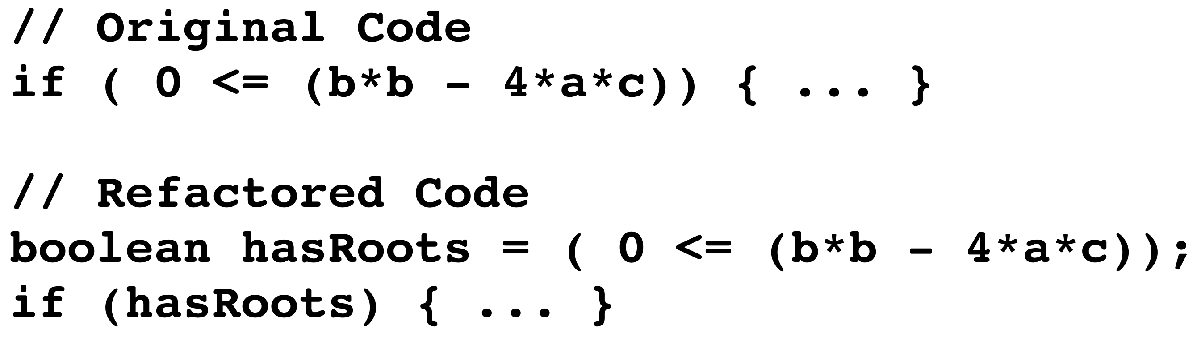
Common Refactorings
Rename:
Rename an entity (a process that is greatly simplified by a good IDE)
Introduce Explanatory (Intermediate) Variables:
Long expressions can be difficult to understand and debug
Extract Sub-Program:
Break a long program or a program that has multiple easily described steps into multiple sub-programs

Slide 18
The Refactoring Process
Test the existing code.
Identify a refactoring.
Make a small change that gets the code closer to the desired code.
Run regression tests and debug if necessary.
If the refactoring is not complete, go to step 3.
If the code needs further refactoring, go to step 2.

Slide 19
Other Kinds of Improvements (i.e., Functional Improvements)
Improved Ease of Use:
Minor changes that make code easier to use (e.g., overloaded methods, convenience methods)
Generalization:
Modifications that make the code applicable in a wider variety of situations (e.g., a wider range of parameter values, more types of parameters)
Increased Functionality:
Adding capabilities (e.g., additional methods)

